Slide 1
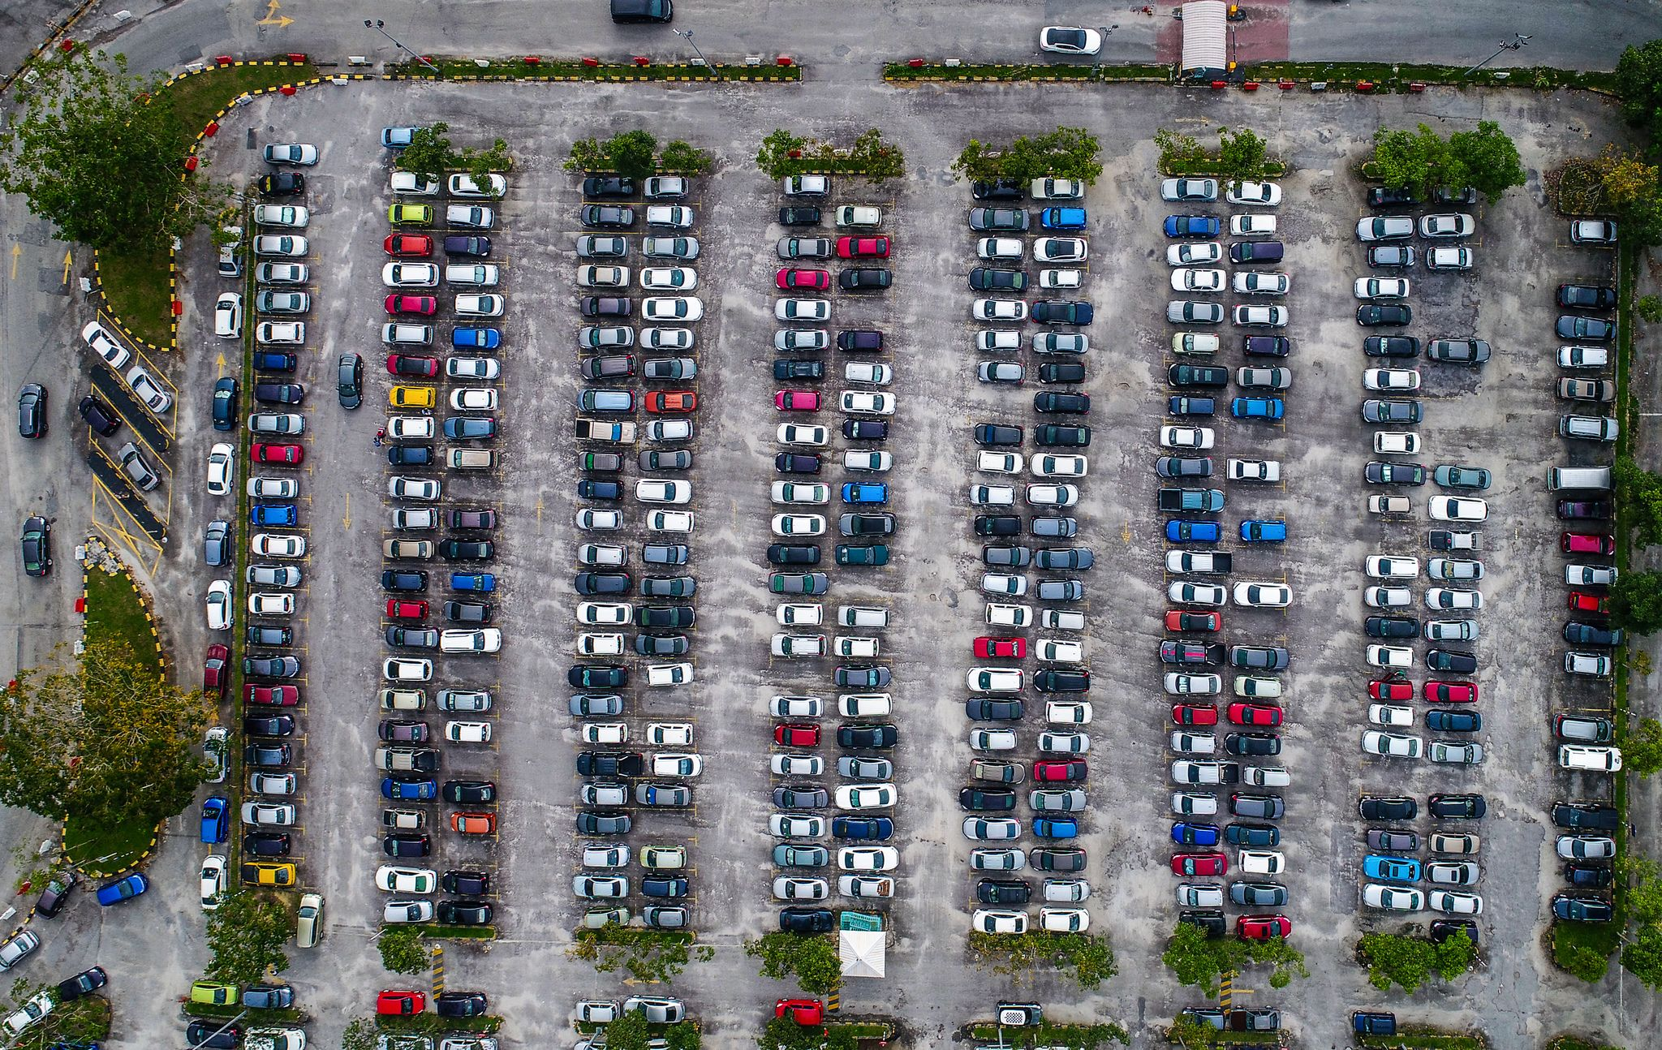
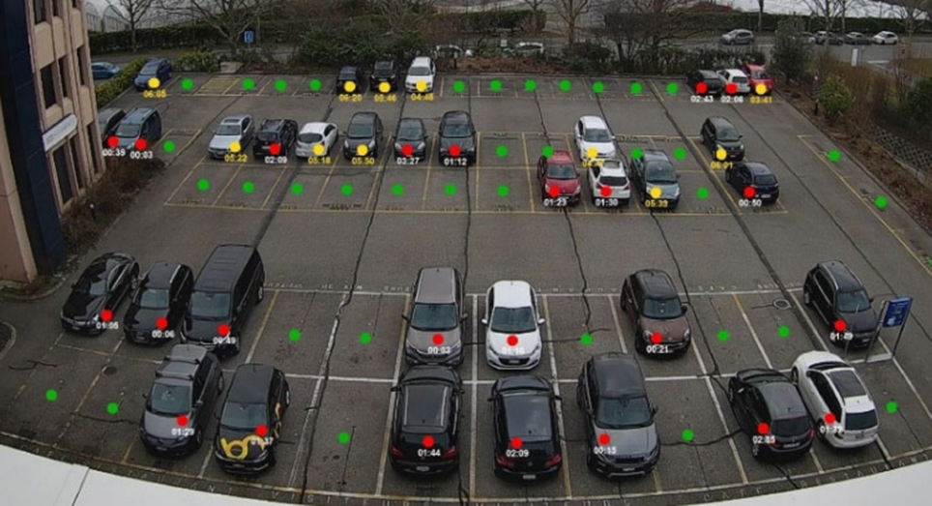
Smart Parking System Based on Computer Vision
Team members:
Yunhui Ma
Menghua Xie

Slide 2
Overall Project Goals and Specific Aims
Goals
·Using Camera to check the parking spot. (CNN)
·creating a map that corresponding to the parking lot.
·The system can manage the data and show the imformation which parking slots are available.
·The information will be transferred to other device and tell users the available parking slots.
Deliverables
· Decide equipment, research, programming language.
· Apply Machine learning to recognize cars (Analysis which models can be used)
· Testing image recognition, optimize the model
· Create a map that correspond to the parking lot.
· Matching the available parking slot
· Sending data to other device (mobile phone)

Slide 3
Project Overview
Motivation
Finding parking spot can be time consuming especially during peak hours.
We know that a lot of indoor parking lots have sensors on each parking slot to detect whether a car is parking.
But the outdoor parking lots do not have this system. Notify drivers the available parking slots especially during the peak time.
Some thoughts
In reality, the ways that people use to identify a parking spot in diferent parking lots are diverse.
Focus on car prediction instead of both car and parking spot.
Match the prediction result with the pre-established map of a certain parking lot and send a message to user’s phone after requesting it by pressing a button.

Slide 4
Technical Approach
Environment and software set up
Yolov5
Anaconda (virtual environment with different libraries for python development)
Pycharm (Python IDE)
cuda10.2
cudnn-10.2-windows10-x64-v7.6.5.32
pytorch1.5.1
Python libraries (numpy, pillow, opencv, and so on)
LabelImg (labeling)

Slide 5
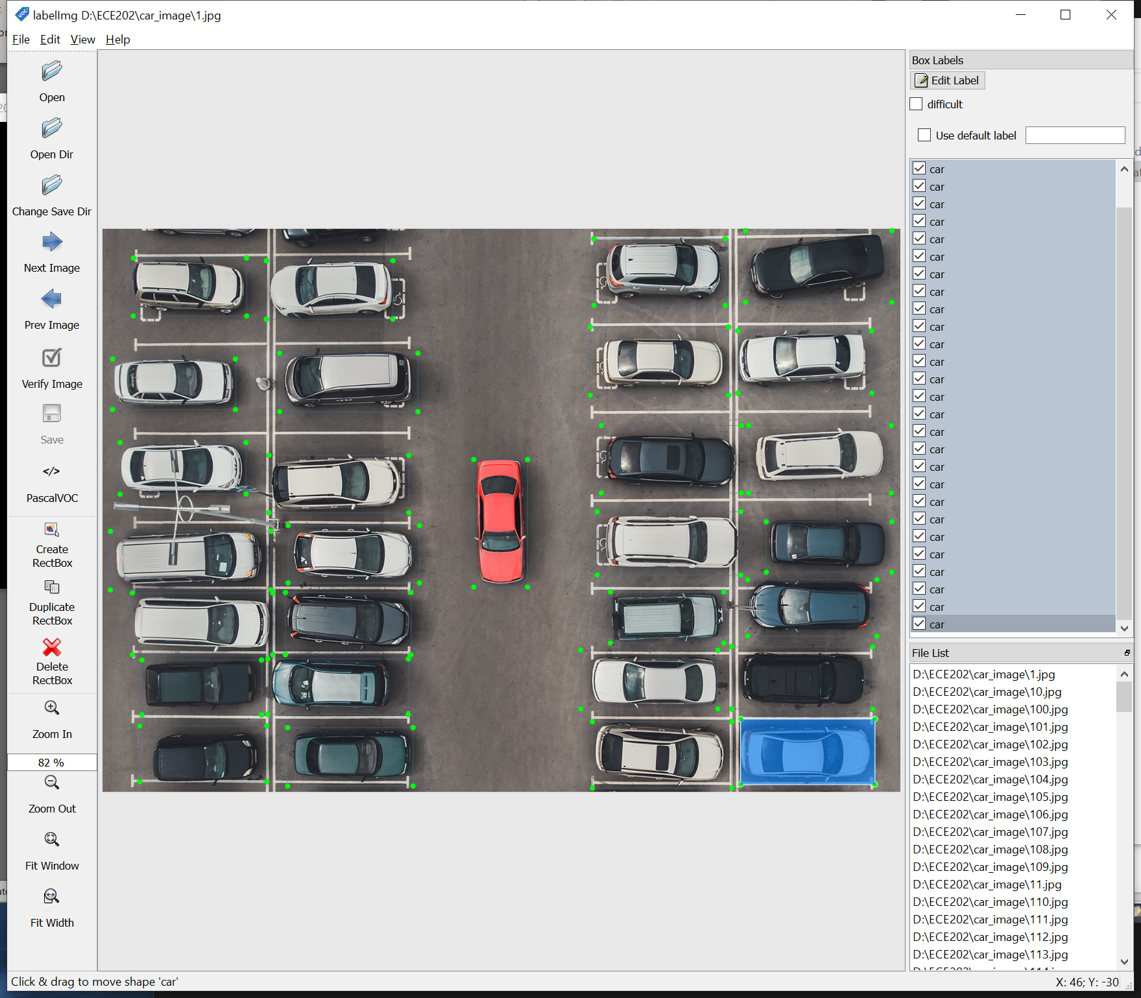
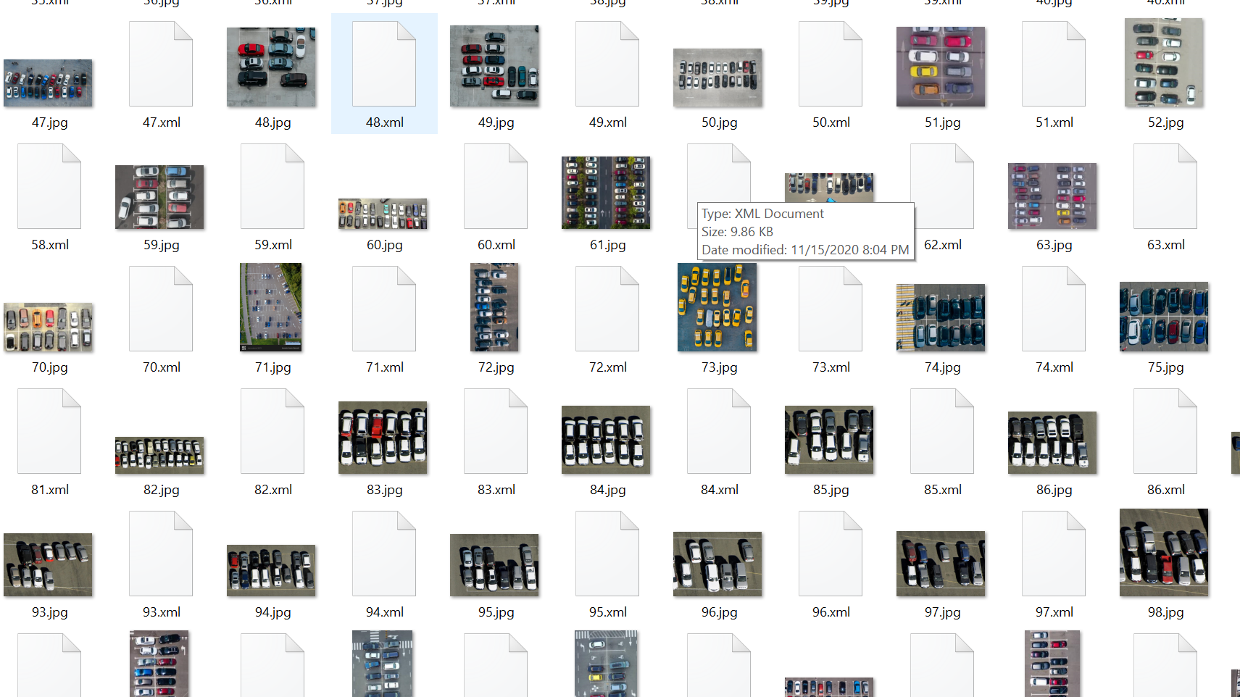
Creating training data set
Part 1: Model training and prediction
About 150 car top view images
Using LabelImg to label out the cars

Slide 6
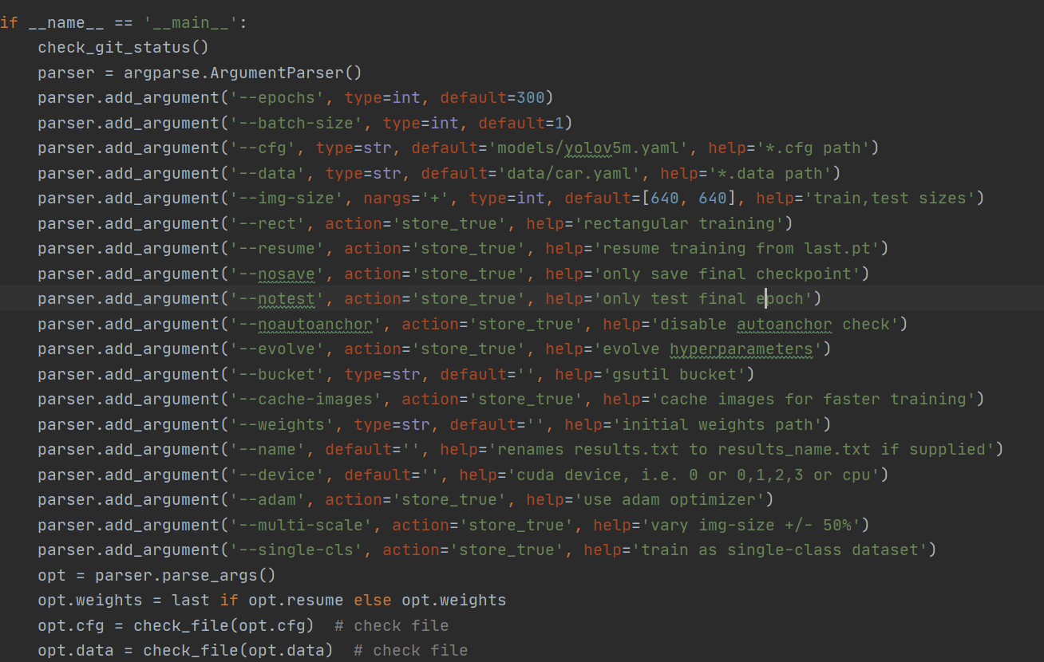
Training Process
epochs = 300
Image size 640x640
yolov5m model

Slide 7
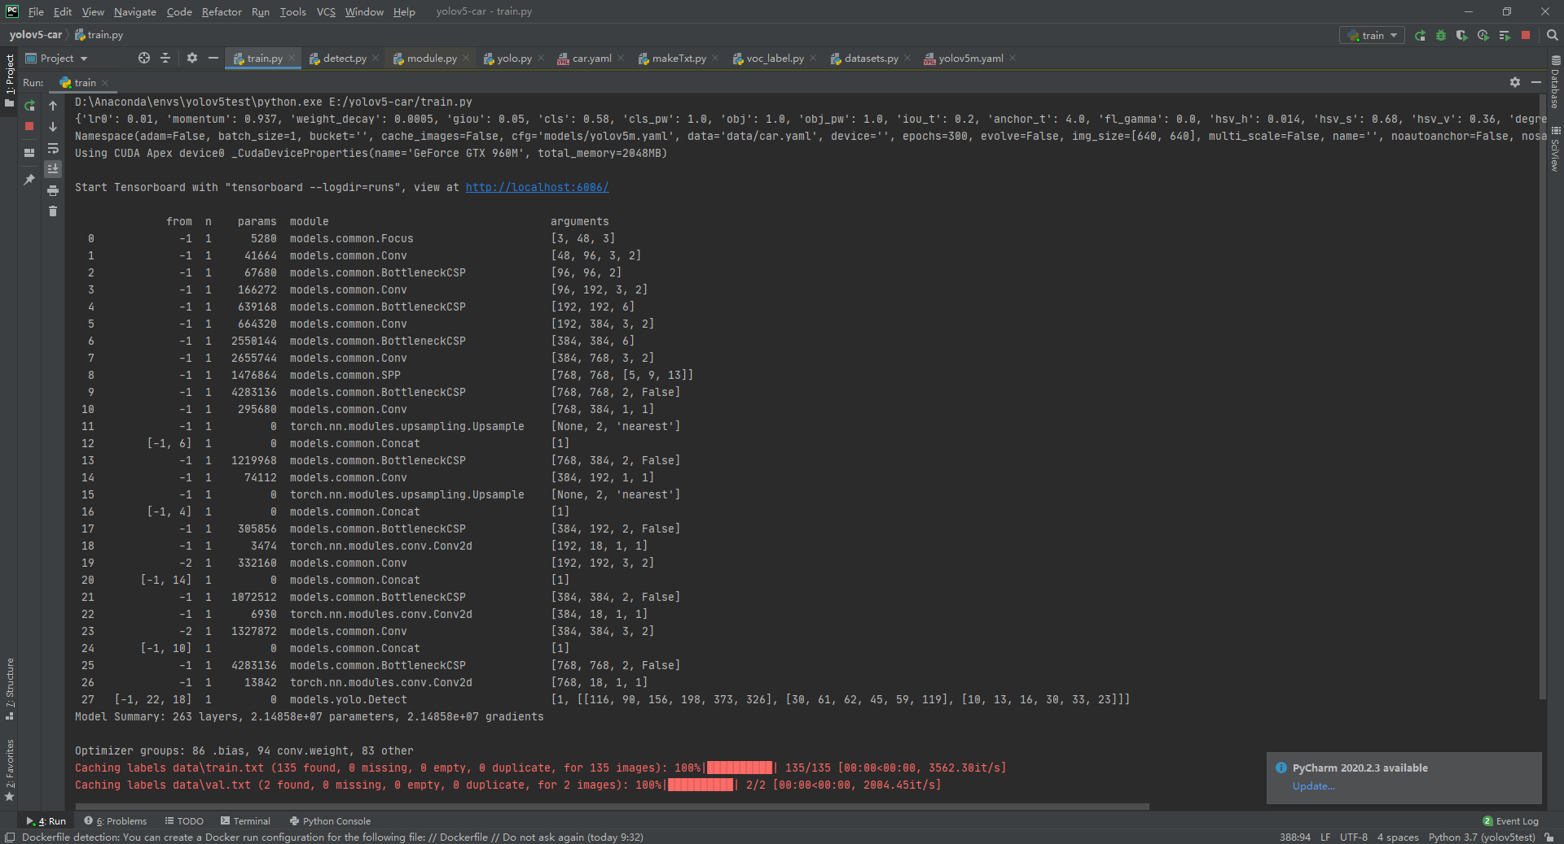
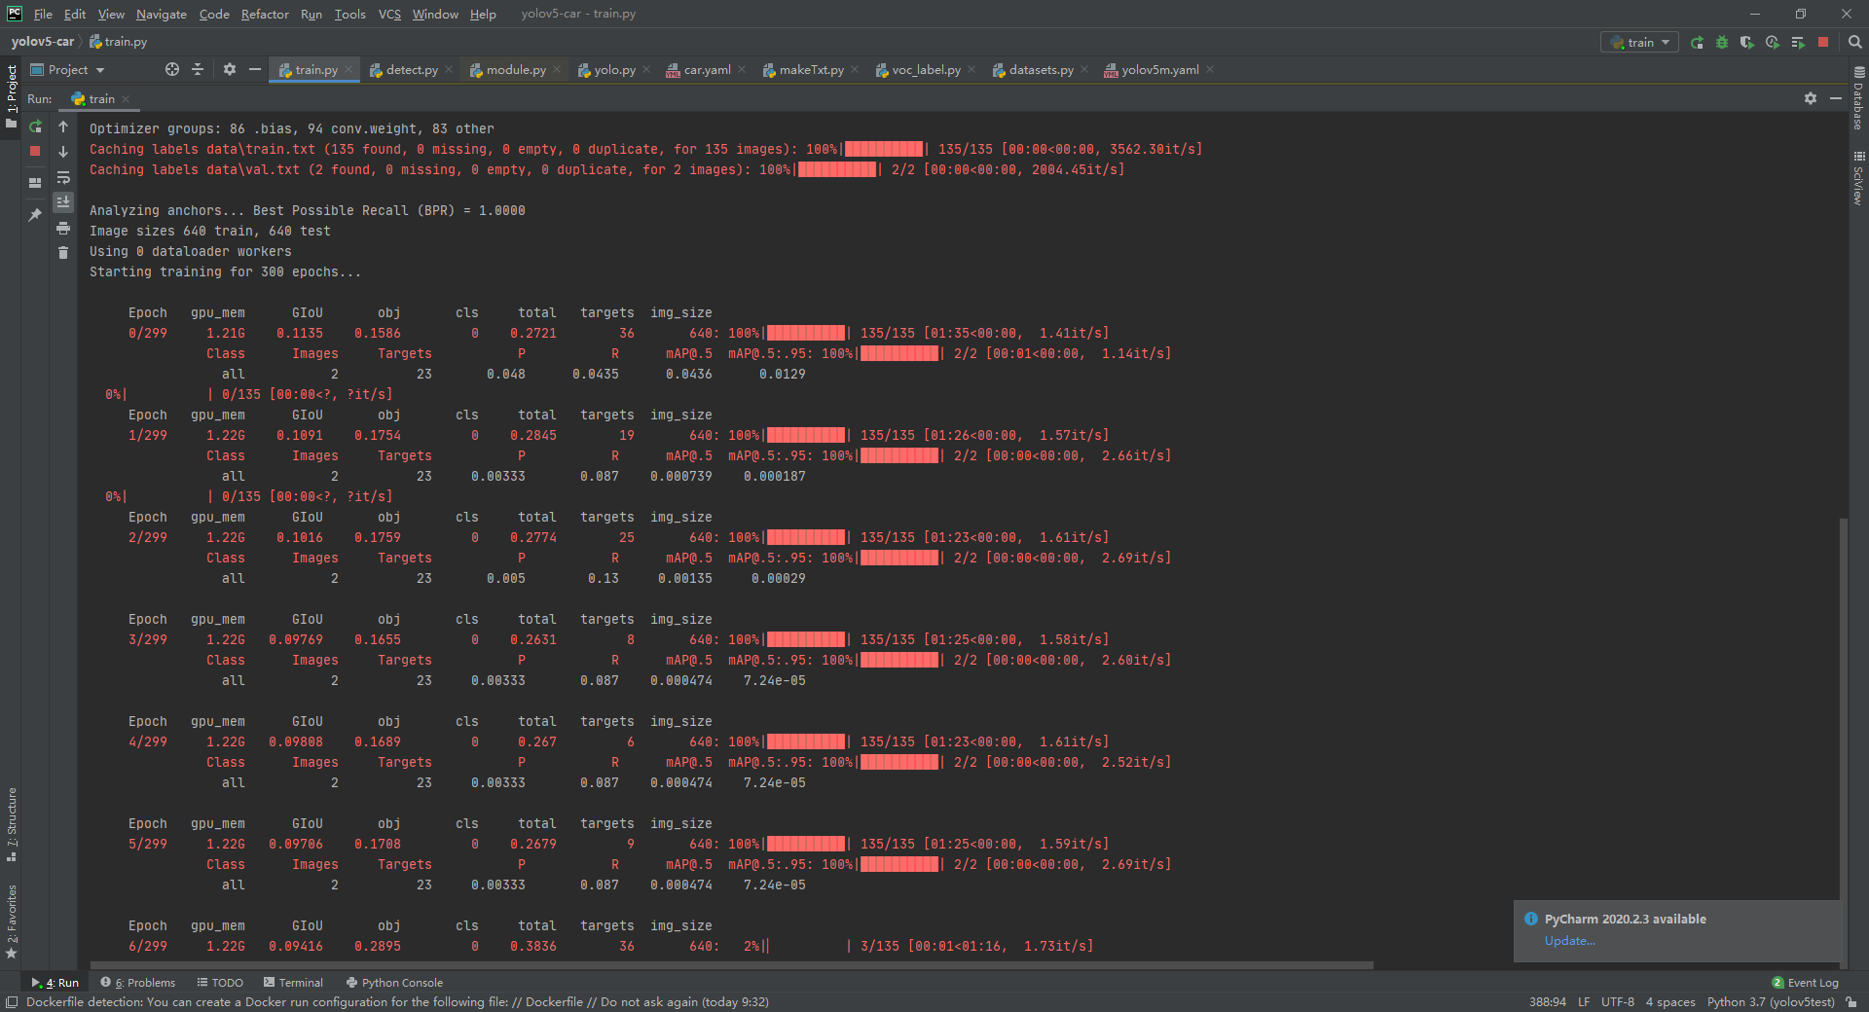
Training Process
estimated time is about 5 hours. (limited by the gpu, GeForce GTX 960M)

Slide 8
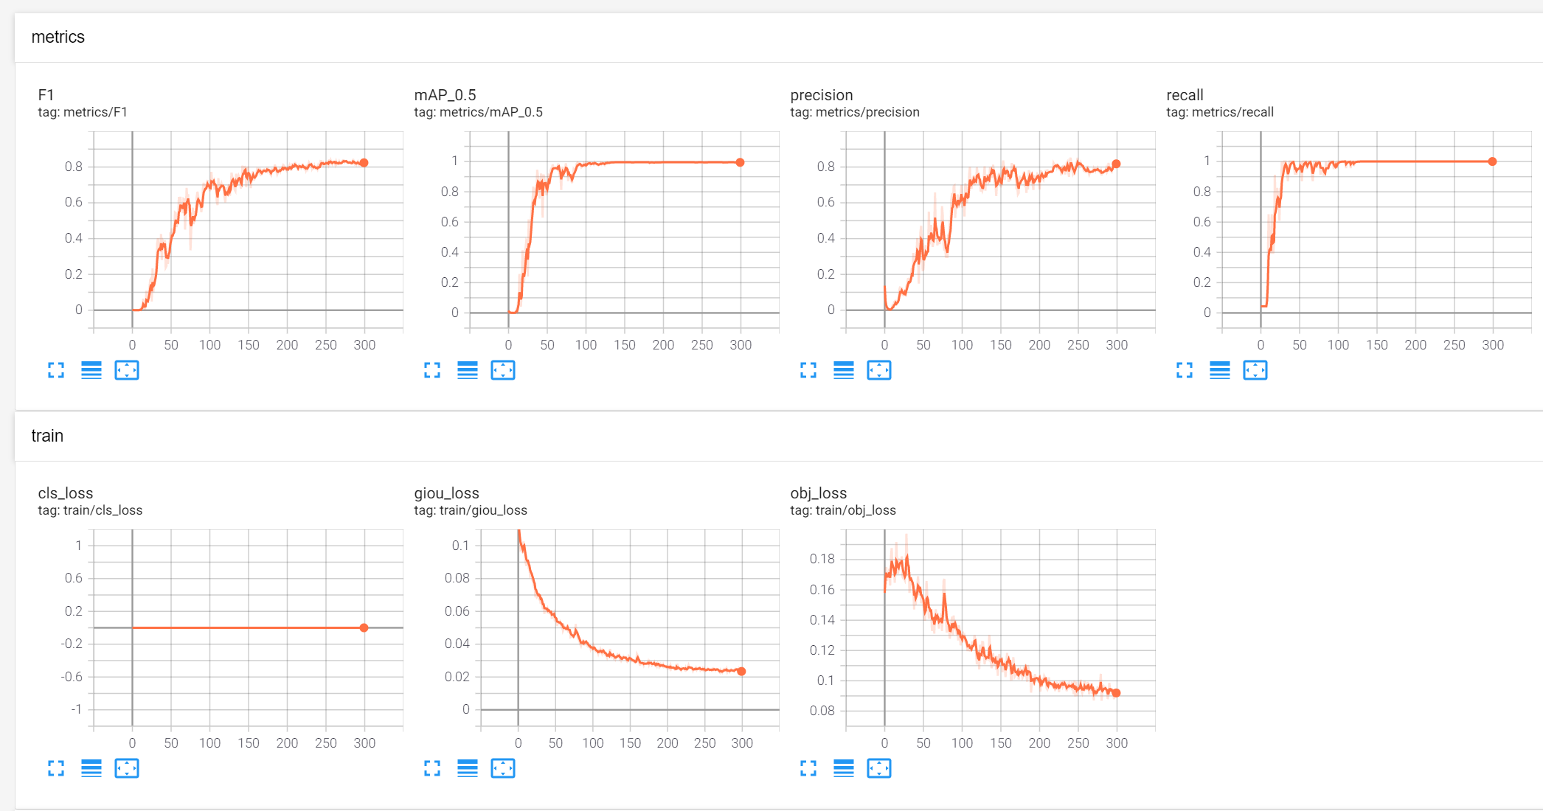

Training Result
Training result: Loss is getting small
Generates a weight file which will be used to predict

Slide 9
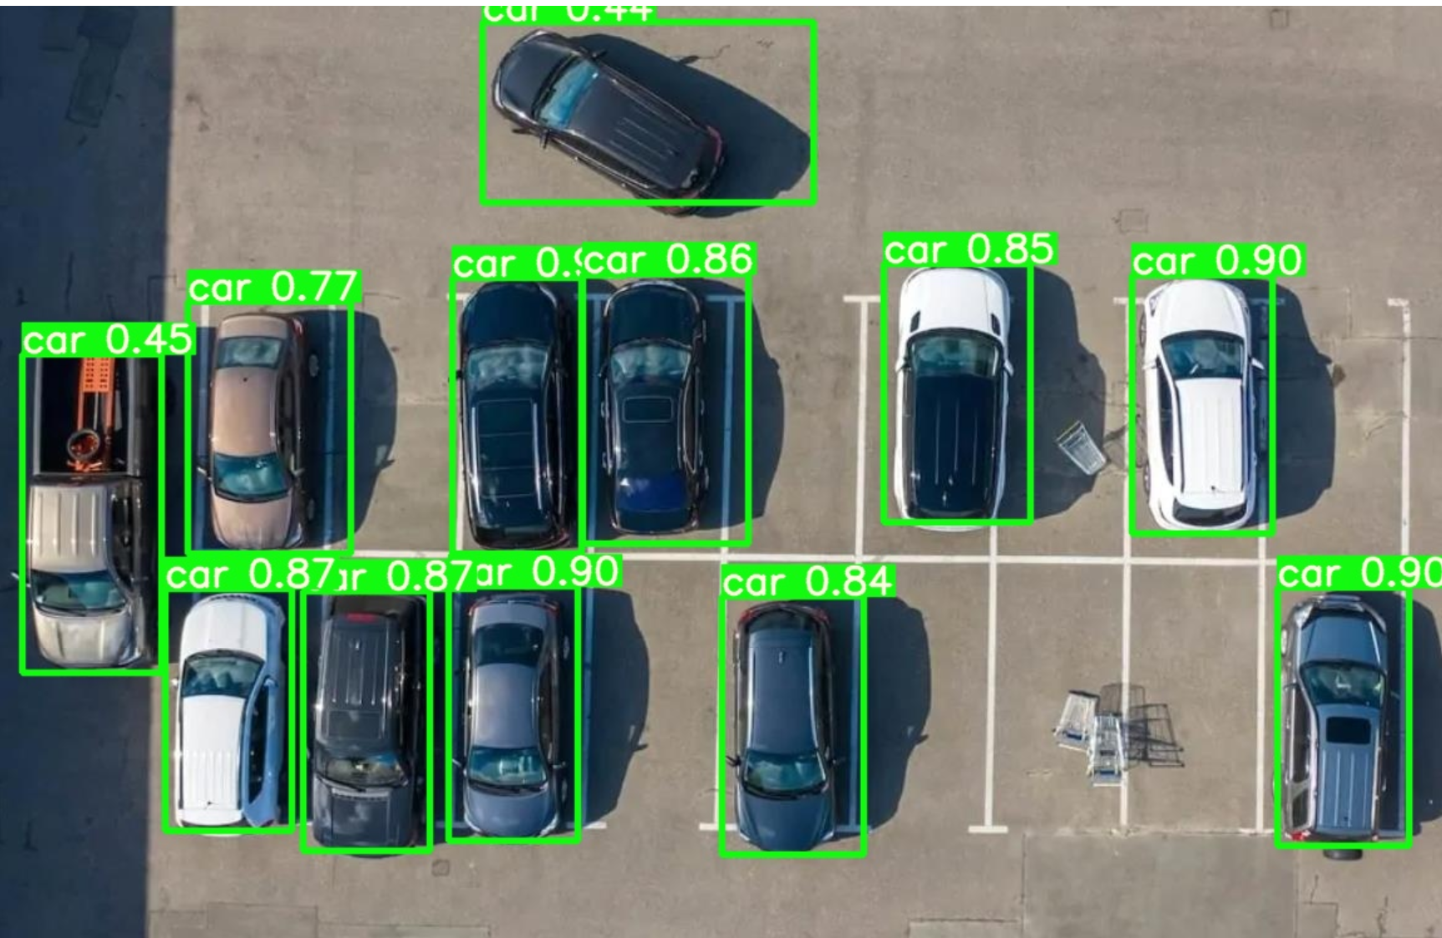
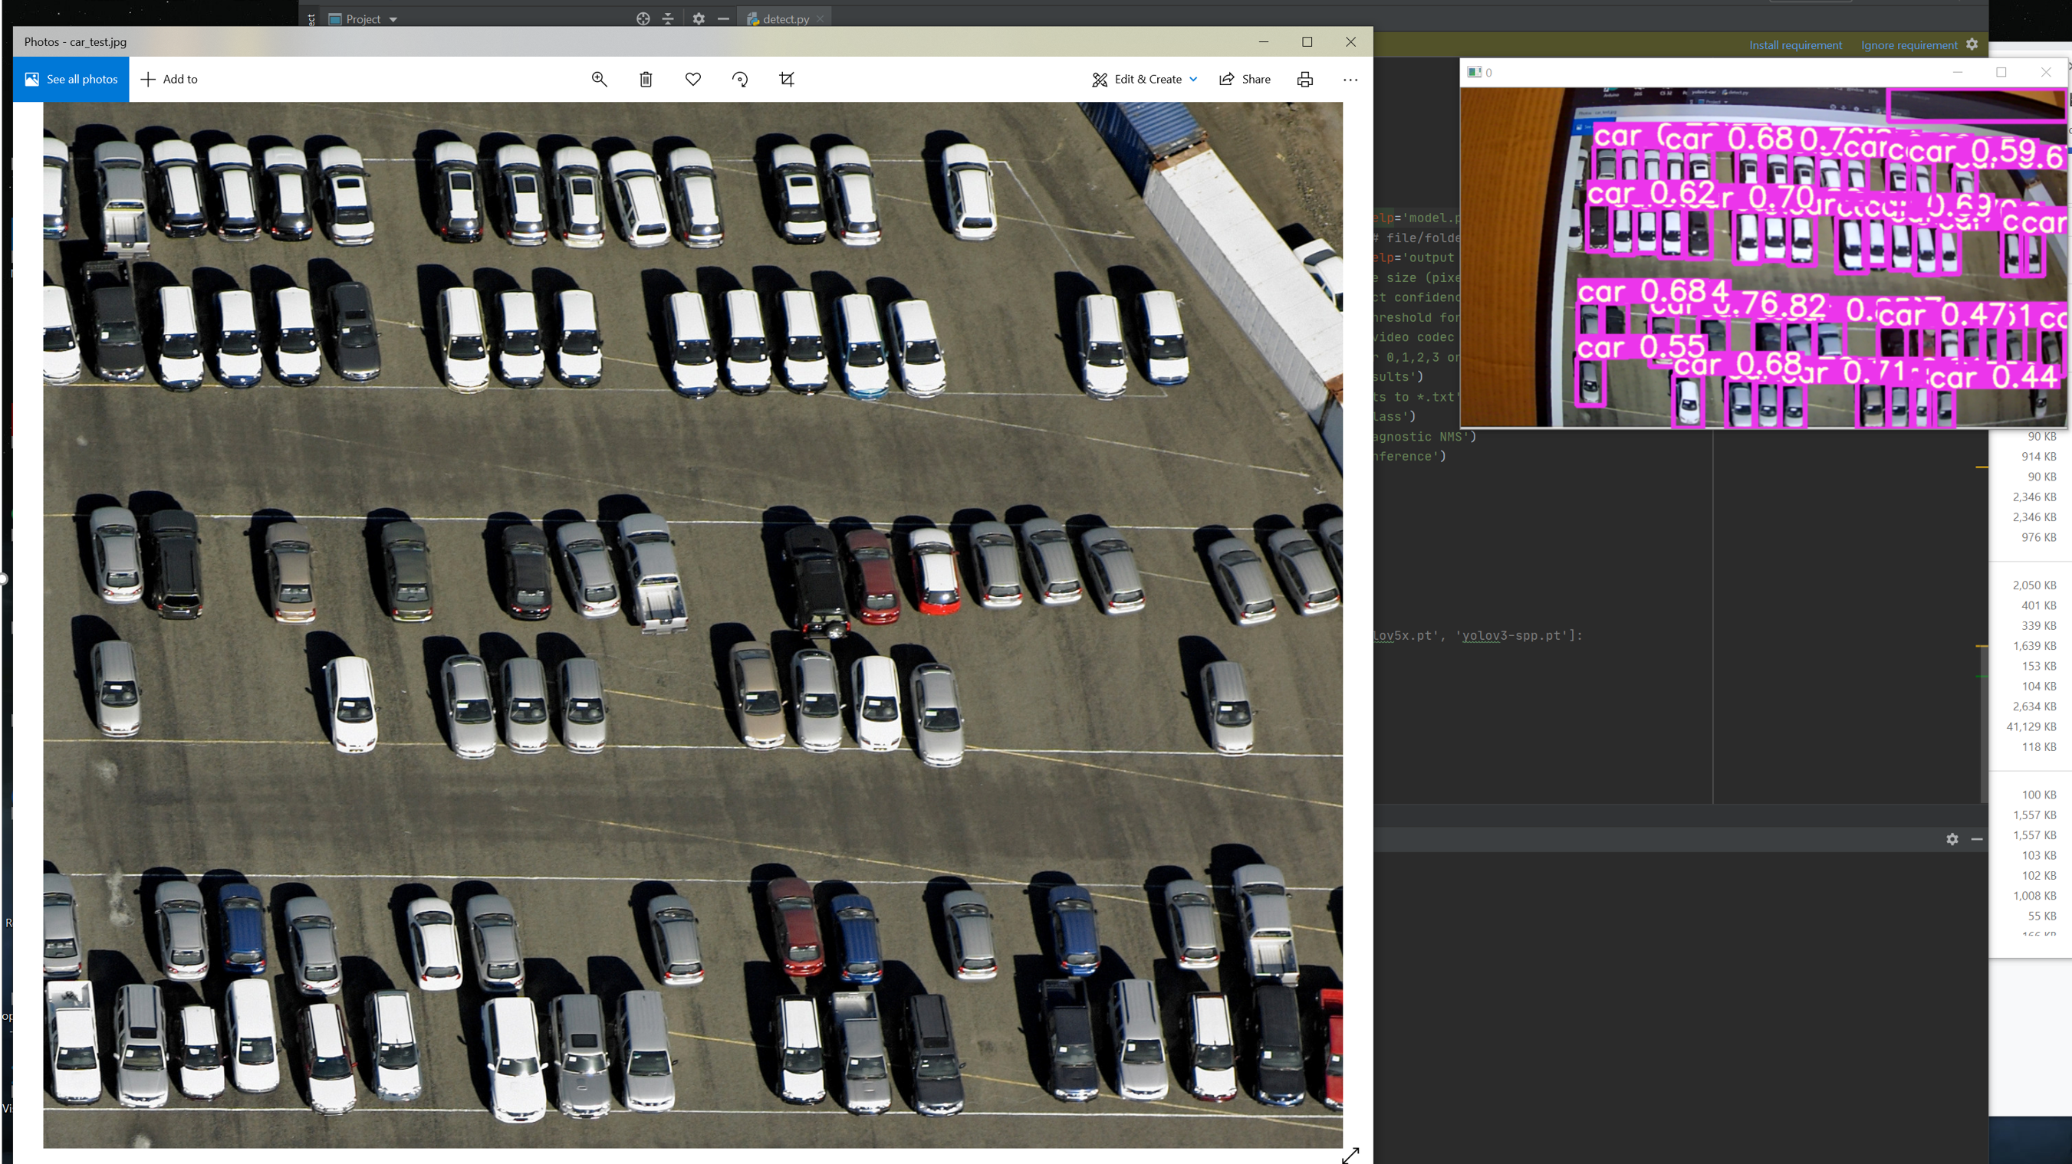
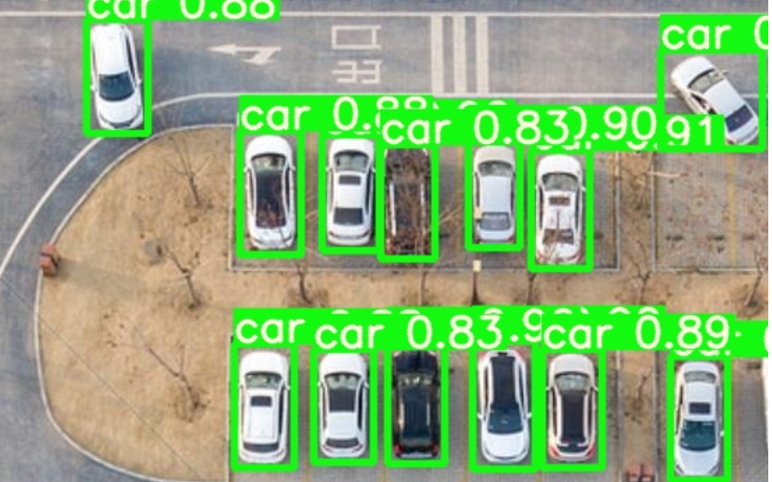
Prediction Result
Current Status
Using camera to test
Loading images to test

Slide 10
Part 2: Creating a map to check whether parking slots are empty
It is difficult to find a recording video in the public parking lot.
In order to simulate the project, we just use 4 images including
14 parking slots and some vehicles in different locations.

Slide 11
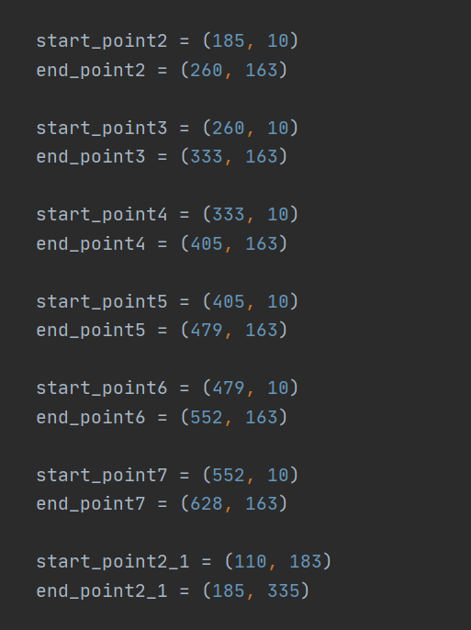
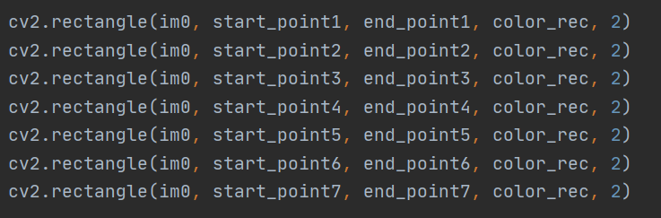
In order to achieve mapping, I firstly draw 14 bounding boxes in the 640x320 video recording camera view. Those 14 bounding boxes positions are fixed. Each boxes would have their own coordinate

Slide 12
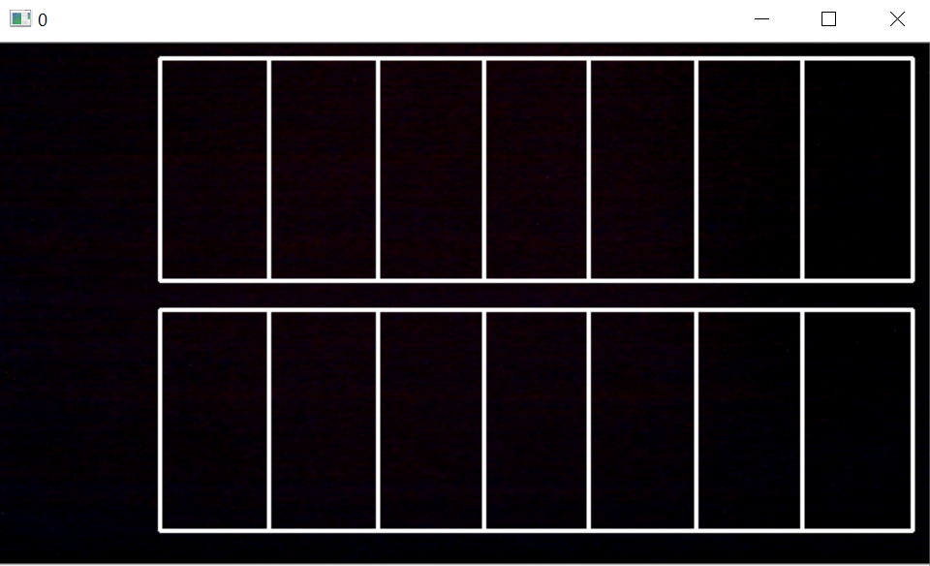
Those bounding boxes would be used to match the parking slots to see whether a car is inside the bounding boxes

Slide 13
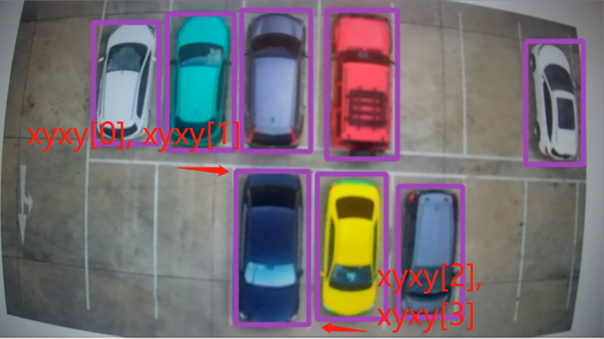
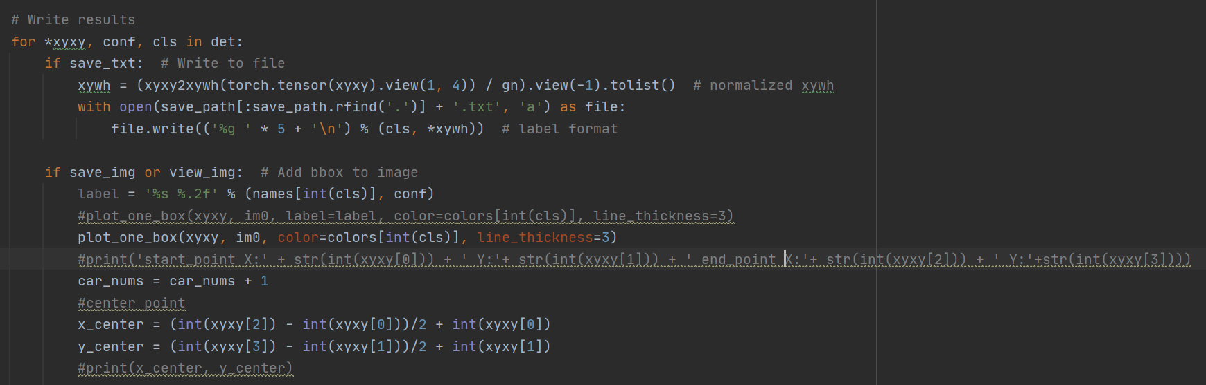
Inside the detect() function, when the algorithm detects the vehicle objects in the video. The vehicle pixel locations (x, y) are stored in the det.
In this for loop, xyxy[] which is obtained from det object is the pixel location corresponding to each detected vehicle.
Obtain their center point

Slide 14
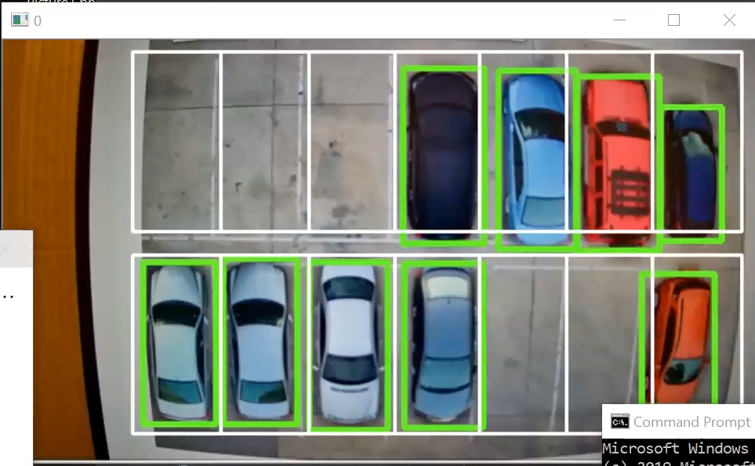

Check their center points to see if they are inside the bounding boxes.
The park_nums[0-13] array is used to recording whether the parking slots are occurred.

Slide 15
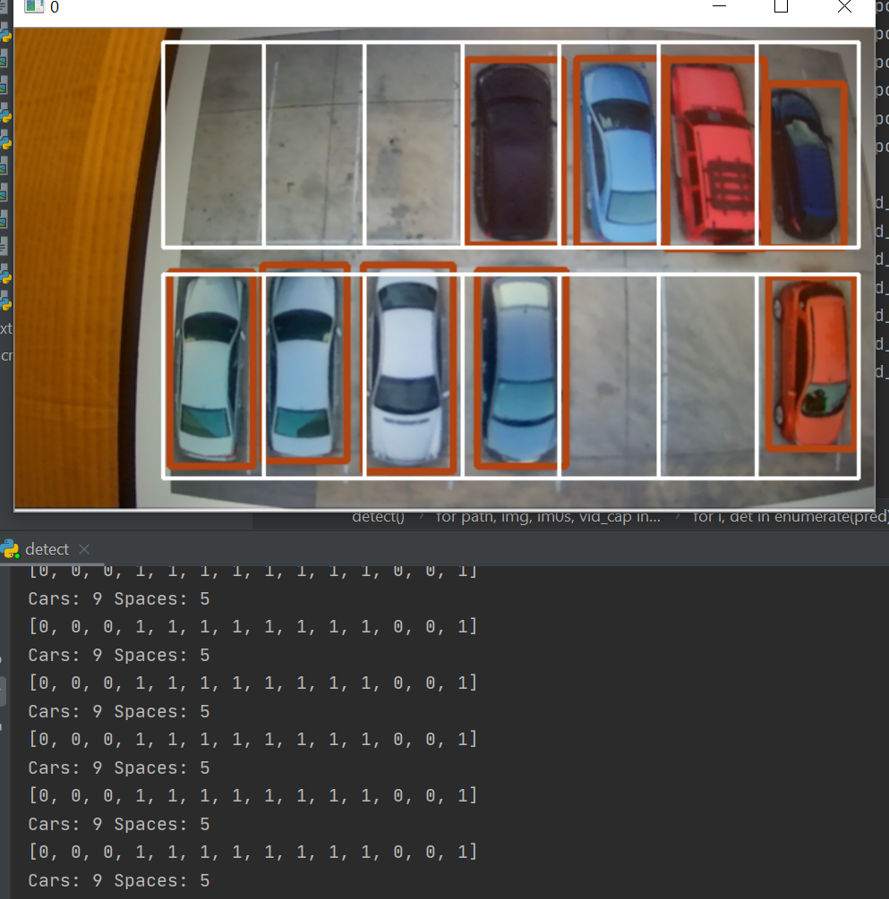
In this case, from the image, we can see that there 5 parking slots are empty. In the terminal,
It is printing out the message showing that the first three, and second and third last parking slots are empty. The rest of parking slots are occurred. 0 represents the empty parking slots, and 1 represents the occurred parking slots.
There are total 9 cars and 5 spaces in this case.

Slide 16
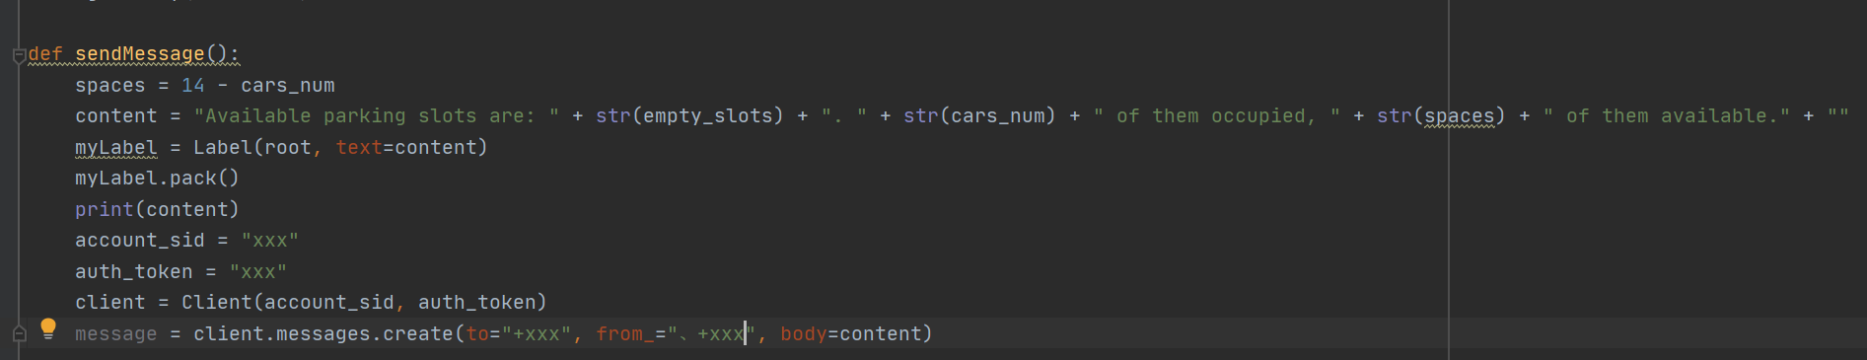
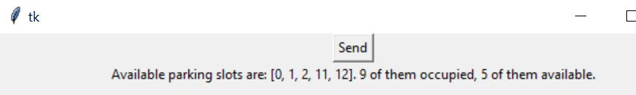
Part 3: Sending message to Phone
Using twilio to send message to phone
Creating a button to send message when pressing

Slide 17
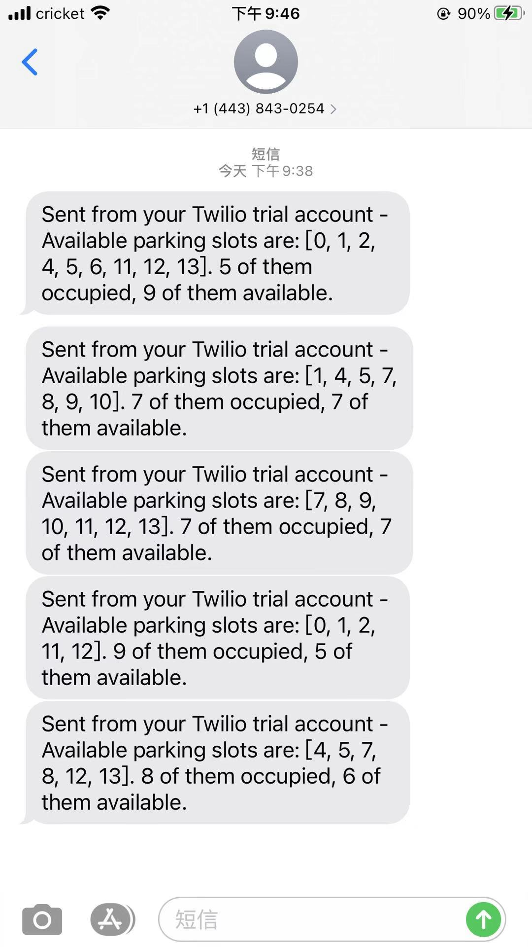
Receiving message
Once I clicked the button, phone would receive a message including the parking space information

Slide 18
Demo
https://youtu.be/imCjEio-sbw

Slide 19
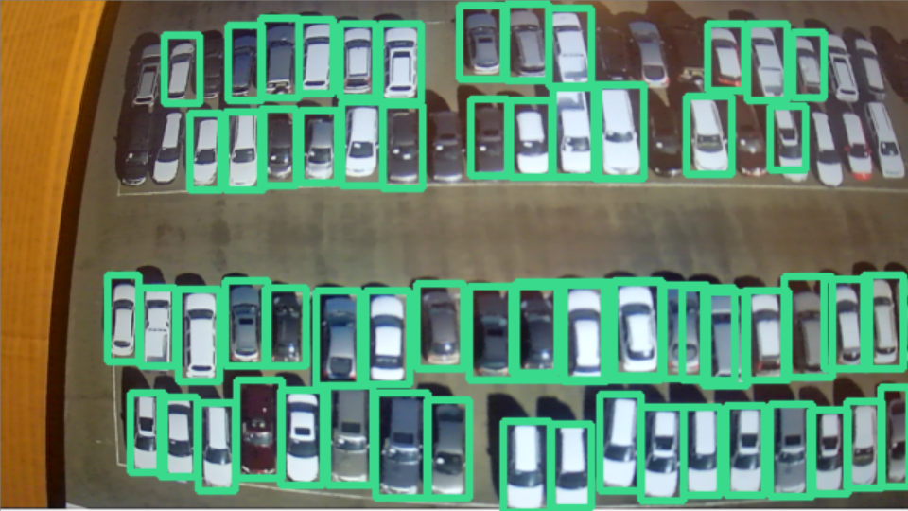
Summary
In this project, it has good prediction on a smaller scale of parking lot such as the demo that we showed.
Testing on larger scale of parking lot would require a lot of images to train in order to get a good prediction result. It is time consuming on training the model. In addition, the training should include different angel of car view. In our project, the training data set only includes the top view of cars.
Due to the limitation of camera, the edges of the image recorded by camera are curved, which would affect the prediction.
It would need a lot of time to create bounding boxes to achieve mapping on the larger scale of parking lots.
The system should work on the outdoor parking lots because the cameras will be equipped at the top of place to get the top view images. Each camera should be able to detect more than 100 parking slots, and it only needs few cameras to capture the whole parking lot.
Due to the higher performance of CNN model, it is affected by external factors.
The system can provide useful message to people to find an available parking slot in large outdoor parking lot during the peak time.

Slide 20
Reference
https://github.com/ultralytics/yolov5
https://www.tensorflow.org/tensorboard
https://www.shutterstock.com/search/parking+lot+top+view
https://blog.csdn.net/nan355655600/article/details/107852353
Presentation Video URL(submitted via google form):
https://youtu.be/kMS5N7UKCuk

